Slide 1
CYBERSECURITY INTERSHIP
WEEK 6 ASSIGNMENT
WEB SECURITY & VULNERABILITY TESTING
Submitted by
Name: Deepashree.C
Role: Cybersecurity Intern
Week: Week 6
SIN: DG/SEPTEMBER/CYBER/254
Submitted to: DG Interns Hub
Topics covered:
o VAPT fundamentals
o OWASP web vulnerabilities: Broken Authentication, Security Misconfiguration
o SQL Injection, XSS(Reflected & Stored)
o Burp Suite traffic analysis
o OWASP ZAP vulnerability scanning
o DVWA practical testing o Risk assessment and mitigation

Slide 2
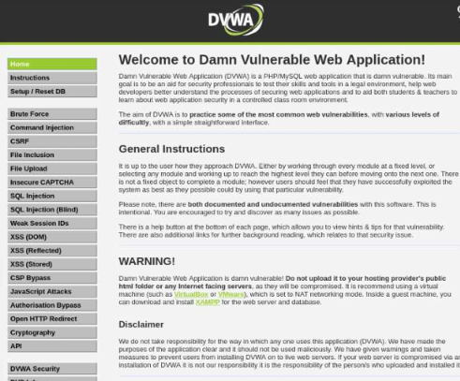
Introduction to VAPT (Vulnerability Assessment and Penetration Testing)
Vulnerability Assessment and Penetration Testing:
VAPT is a security testing process used to identify, analyze, and validate vulnerabilities in systems and web applications.
Objectives:
Identify web application security weaknesses.
Understand common vulnerabilities in an authorized environment.
Analyze HTTP requests and responses.
Assess risk levels and potential impacts.
Recommend suitable mitigation techniques.
Testing Environment:
Target: DVWA (Damn Vulnerable Web Application)
Environment: Local/authorized lab
Tools: Burp Suite and OWASP ZAP
Approach: Manual testing and automated scanning
Fig: DVWA Web Application Testing Environment

Slide 3
Study of OWASP Vulnerabilities
Vulnerability | Definition | Impact | Prevention
Broken Authentication | Weak authentication or improper session handling allows attackers to access user accounts. | Account hijacking, identity theft, and unauthorized access. | Use strong passwords, MFA, secure session management, and login rate limiting.
Security Misconfiguration | Incorrect or insecure application, server, or system settings expose security weaknesses. | Data leakage, unauthorized access, and privilege escalation. | Disable default accounts, apply security patches, remove unnecessary services, and perform regular security audits.

Slide 4
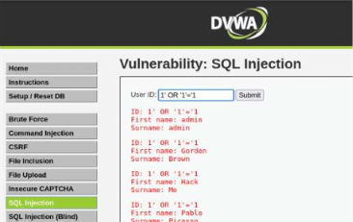
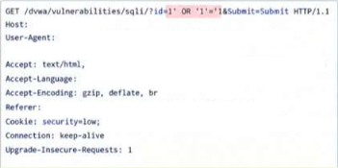
SQL Injection Testing
SQL Injection:
SQL Injection is a web application vulnerability that occurs when untrusted user input is incorrectly handled in SQL queries, potentially allowing attackers to interfere with database operations.
Testing Performed:
Examined the SQL Injection module in DVWA.
Submitted controlled test inputs in the authorized lab.
Observed and analyzed the application's responses.
Intercepted and inspected HTTP requests using Burp Suite.
Impact:
Unauthorized access to database records.
Exposure or modification of sensitive information.
Potential authentication bypass.
Mitigation:
Use prepared statements and parameterized queries.
Validate user input appropriately.
Apply least-privilege permissions to database accounts.
Avoid building SQL queries through direct string concatenation.
Fig: SQL Injection Test Performed on DVWA
Fig : Burp Suite Intercepted SQL Injection Request

Slide 5
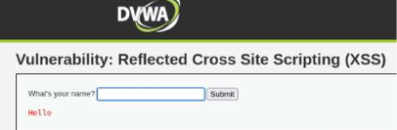
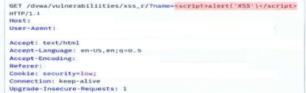
Cross-Site Scripting (XSS)
Cross-Site Scripting (XSS) is a web vulnerability in which improperly handled user input is interpreted as executable code in a user's browser.
Types Tested
Reflected XSS: Malicious input is reflected in the application's response and may execute immediately in the browser.
Stored XSS: Untrusted input is saved by the application and may execute when another user views the affected content.
Testing Performed:
Tested Reflected and Stored XSS in DVWA.
Observed browser-side behavior using controlled test inputs.
Captured and analyzed HTTP requests using Burp Suite.
Mitigation:
Apply context-aware output encoding.
Validate and sanitize user input where appropriate.
Implement a Content Security Policy (CSP).
Handle user-generated content securely.
Fig: Reflected XSS Testing in DVWA
Figure: Burp Suite Request Captured During XSS Testing

Slide 6
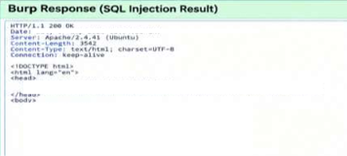
Burp Suite Request & Response Analysis
HTTP Traffic Inspection: Burp Suite was used as an interception proxy to analyze HTTP communication between the browser and the DVWA application.
Activities Performed
Captured and inspected HTTP requests.
Analyzed request parameters and user inputs.
Reviewed server responses and status codes.
Observed application behavior during vulnerability testing.
Evidence Collected
HTTP methods and requested URLs.
Request parameters and test inputs.
Server response status codes and content.
Observed application behavior and potential vulnerabilities.
Figure: Burp Suite Captured HTTP Request & Response of SQL

Slide 7
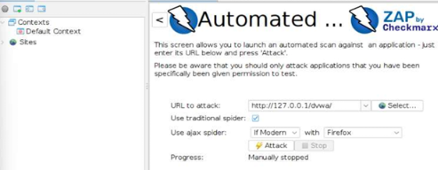
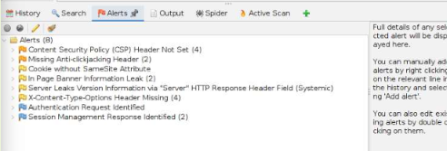
OWASP ZAP Scanning and Findings
Automated Vulnerability Scanning: OWASP ZAP was used to scan the authorized DVWA environment and identify potential web application security issues.
Scan Process:
Configure the target application.
Crawl the application to discover pages and endpoints.
Perform an automated security scan.
Review and analyze the generated alerts.
Findings:
The scan results were classified according to risk levels:
High: Critical security concerns.
Medium: Potentially exploitable weaknesses.
Low: Minor security issues.
Informational: Observations and security recommendations.
Risk Assessment:
The identified alerts were reviewed to evaluate their potential impact, verify relevant findings, and recommend suitable mitigation measures.
Figure: DVWA Target Configured in OWASP ZAP
Figure: OWASP ZAP Alerts/Findings

Slide 8
Mitigation & Conclusion
Key Mitigation Measures:
Use parameterized queries to prevent SQL Injection.
Validate user input and apply context-aware output encoding to prevent XSS.
Implement strong authentication and secure session handling.
Remove insecure configurations and disable unnecessary services.
Update software and dependencies regularly.
Configure appropriate security headers.
Conduct periodic vulnerability assessments and penetration testing.
Conclusion:
The Week 6 practical introduced web application security testing using DVWA in an authorized lab environment. Burp Suite was used to inspect HTTP traffic, while OWASP ZAP helped identify potential security issues through automated scanning. Testing SQL Injection and XSS highlighted common web application risks and the importance of effective security controls.
Key Learning:
Identify → Test → Analyze → Evaluate Risk → Mitigate → Verify

